Slide 1

DIGITAL REMOTE HEALTHCARE
BY: Team JavaChip
Gauri Verma 001306996
Rishabh Sood 001300579

Slide 2

PROBLEM STATEMENT
In India, 62% of the population still lives in the rural areas and is deprived of proper healthcare services leading to an increased number of deaths. The rising number of health problems and diseases are increasing exponentially. People are barely able to have access to basic primary healthcare facilities which are not able to cater to the plethora of diseases.
To help provide such people with more specialized services remotely, we are creating a system where the primary/regional healthcare provider is able to communicate with more supervised and specialized providers to cater to the needs of the people in the rural areas.

Slide 3
APPROACH
Consider a primary care center in a rural area catering to the medical needs of the people.
The provider from the primary care center will gather patient information(medical issues) and forward it to the digital healthcare provider.
The digital remote healthcare provider receives the work request and processes it. The request is handled by either forwarding it for lab tests, or writing a prescription.
The prescription is processed by the local medical store, who asks for restock from the pharmacy if needed, and supplies to patient.
The lab test request is processed by the lab technician in the rural area. The lab test reports are sent back to the digital provider who assesses it and gives the appropriate prescription for the patient.

Slide 4
KEY FUNCTIONALITIES Primary healthcare provider
Register patient
Capture patient demographic details
Capture details of patient’s medical problems
Provide lab testing facilities
Provide medicines
Forward the request to the digital practitioner for the medical evaluation of the patient.

Slide 5
KEY FUNCTIONALITIES Digital Healthcare Provider
Receive patient details and medical history from primary healthcare provider
Diagnose the medical problem based on the symptoms and medical history of patient
Suggest further action(s) to be taken
Request for lab tests to be done, if needed
Prescribe medications as required
Forward the request to the primary healthcare provider.

Slide 6
ACTORS:
Primary Healthcare Provider
Lab Technician
Medical Store Provider
Digital
Healthcare Provider
Pharmacy

Slide 7
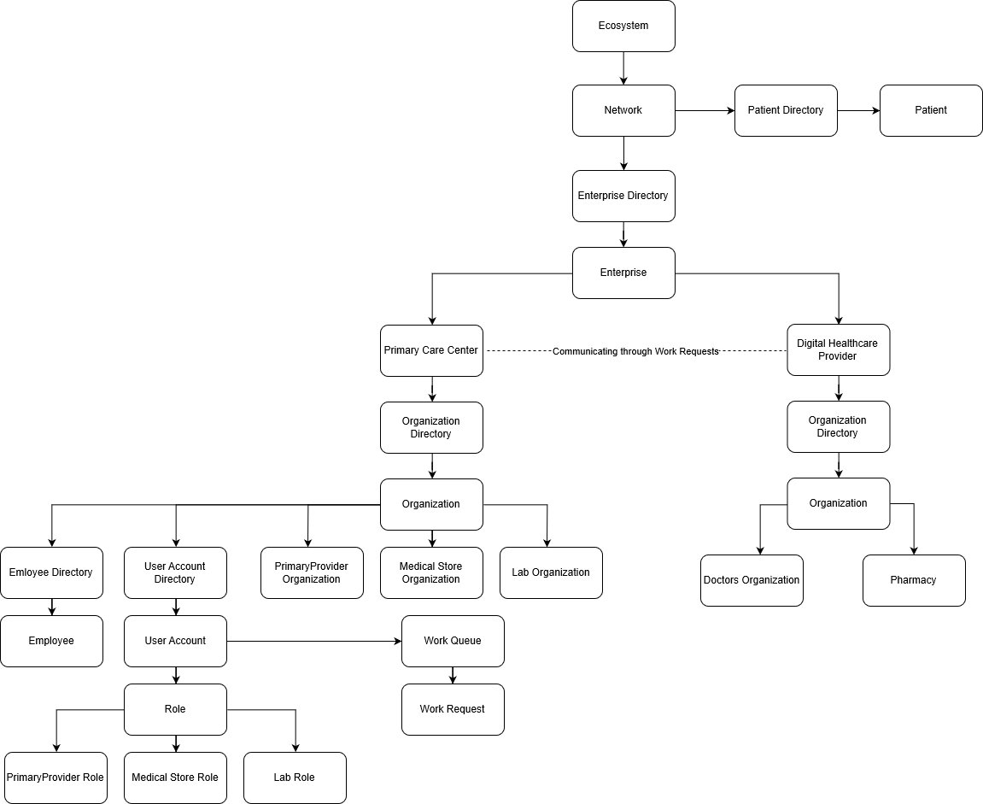
ECOSYSTEM

Slide 8
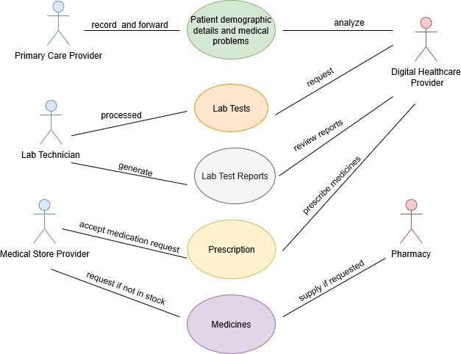
USE CASE DIAGRAM

Slide 9
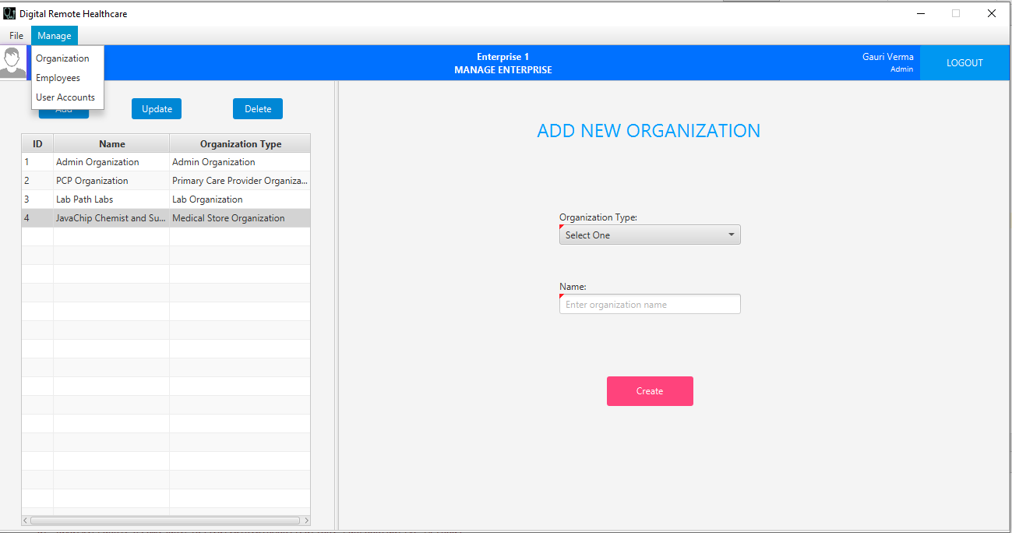
KEY SCREENSHOT
Added menu toolbar for easy navigation between pages

Slide 10
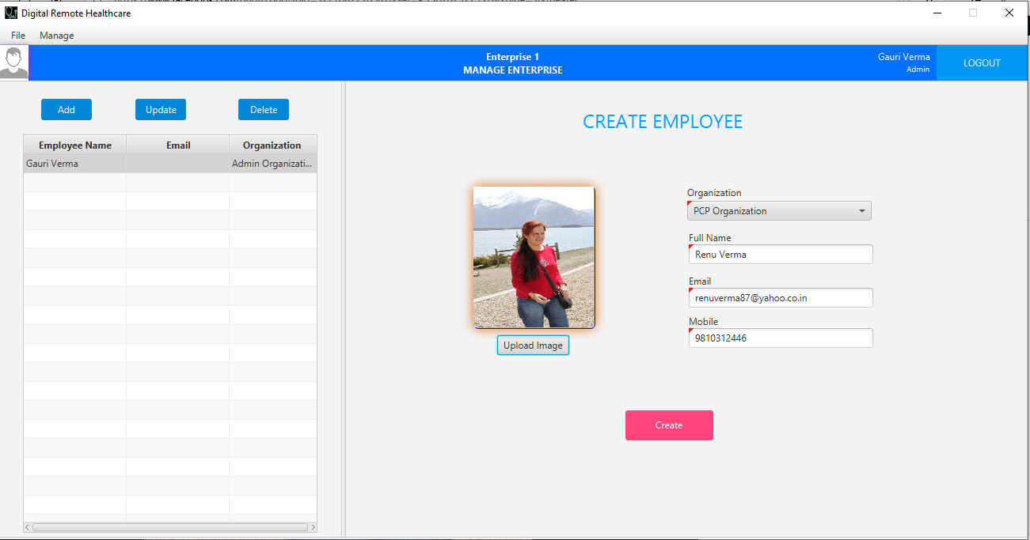
KEY SCREENSHOT
Upload and store employee profile picture

Slide 11
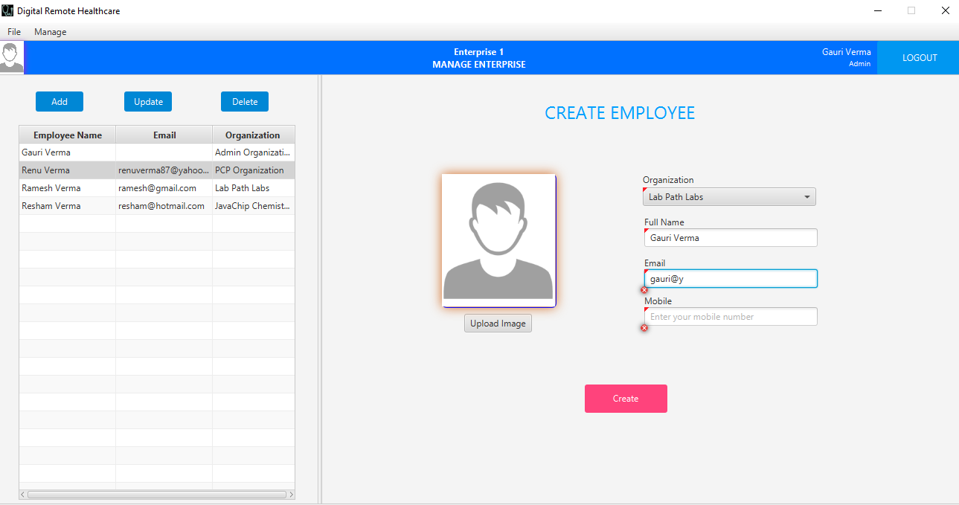
KEY SCREENSHOT
Validations as you type

Slide 12
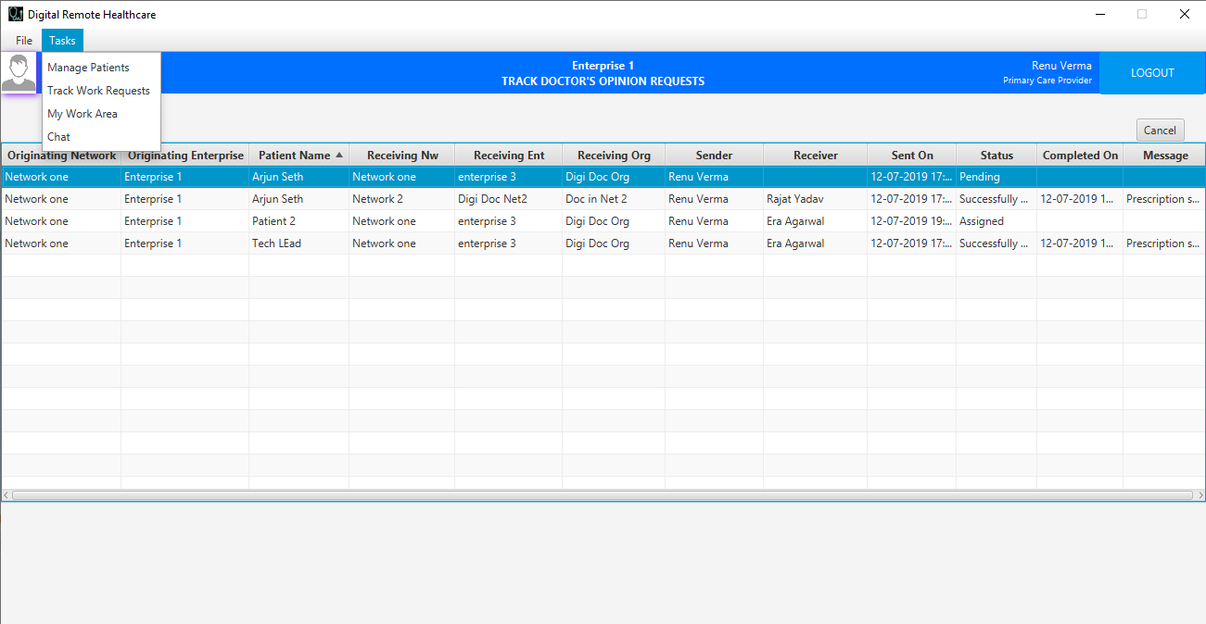
KEY SCREENSHOT
Handle multiple work requests and track them using ‘Work Area’

Slide 13
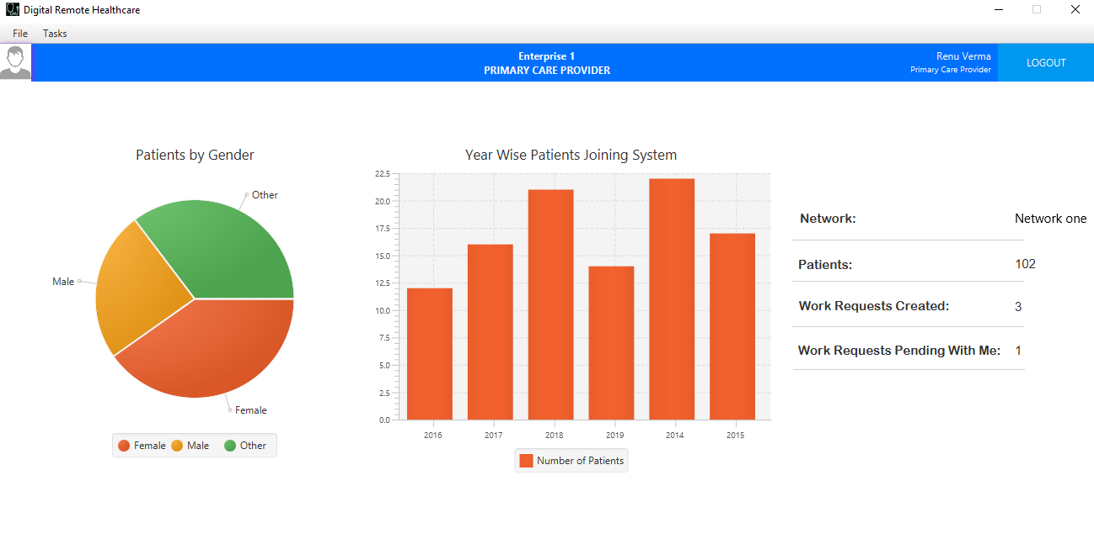
KEY SCREENSHOT
Pictorial representation using pie-chart and bar-graph

Slide 14
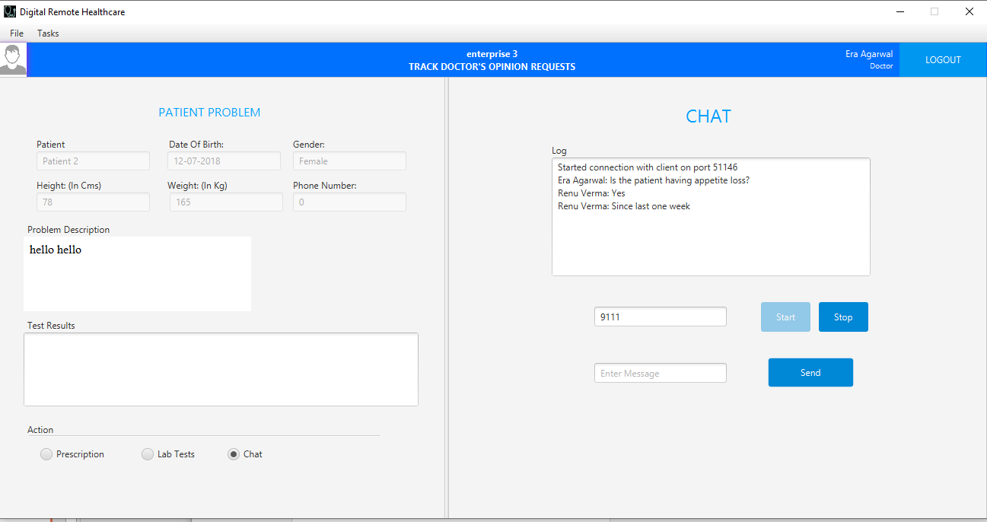
KEY SCREENSHOT
Chat option between digital remote doctor and primary healthcare doctor

Slide 15
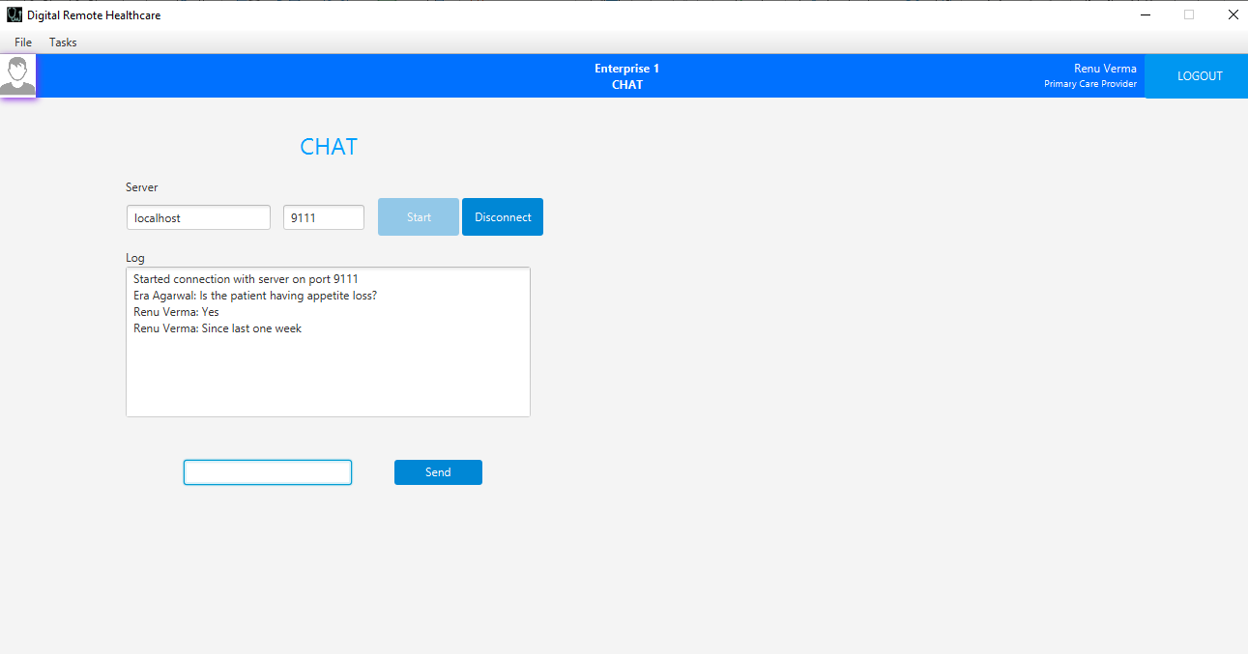
KEY SCREENSHOT
Chat option between digital remote doctor and primary healthcare doctor

Slide 16
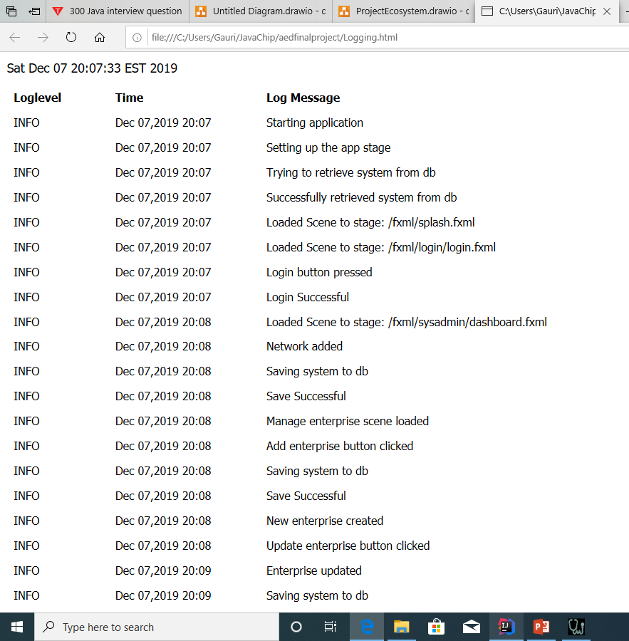
KEY SCREENSHOT
Maintained log of actions performed

Slide 17
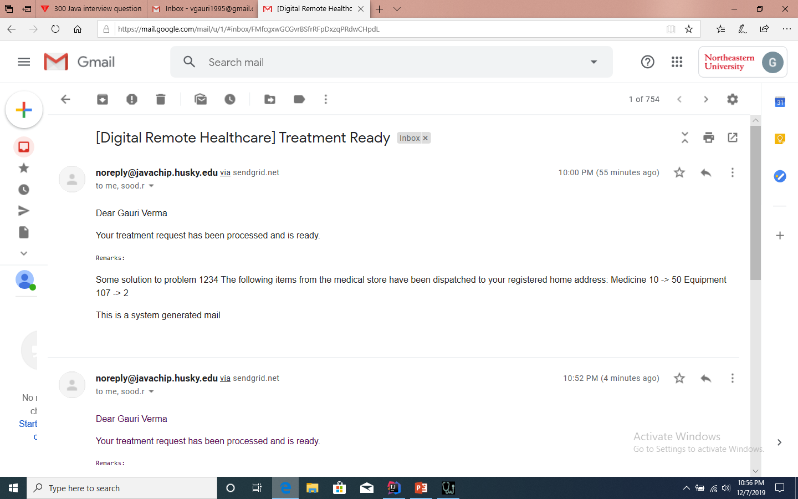
KEY SCREENSHOT
Email sent to patient

Slide 18
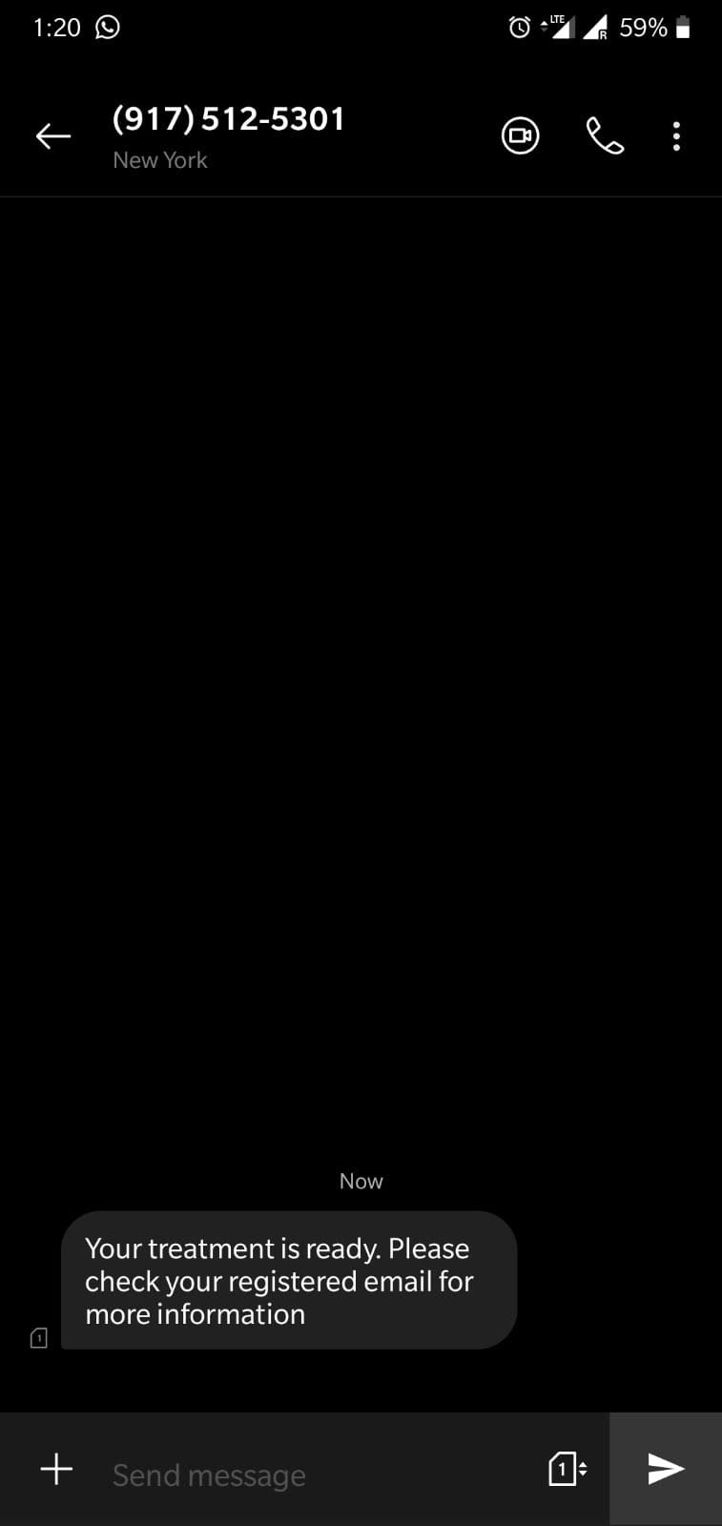
KEY SCREENSHOT
Text message sent to patient

Slide 19

THANK YOU

